Slide 1
AVL Trees
https://www.cs.usfca.edu/~galles/visualization/AVLtree.html

Slide 2
Balanced Binary Tree
For every node in such a tree, the height of left subtree and the height of the right subtree can differ by at most one.

Slide 3
Worst case behavior of BST
Height of an almost balanced BST containing N nodes is approx. log2N
  Thus aprox. log2N operations(steps) required for typical retrieval, insertion, and removal operations

Slide 4
Words have been inserted into the following initially empty tree in random order. Worst case retrieval requires 4 operations (comparisons).
the
dent
those
blue
mint
there
black
then

Slide 5
  Black blue dent mint the then there those
What if we try to insert elements in alphabetical order
So we are concerned about minimizing worst case behavior . We wish to consider trees that have a guaranteed O(logN) behavior in the worst case

Slide 6
AVL Trees
An AVL tree is a binary search tree with a balance condition
  To ensure that the height of the tree is O(logN)
  For every node in the AVL tree, the height of left subtree and the height of the right subtree can differ by at most one.

Slide 7
AVL Trees
5
7
2
8
2
8
1
4
7
1
4
3
3
5
An AVL Tree
Not an AVL Tree

Slide 8
AVL Trees
Given an AVL tree, if insertions or deletions are performed, the AVL tree may not remain height balanced.
To maintain the height balanced property of the AVL tree after insertion or deletion, it is necessary to perform a transformation on the tree so that
  the transformed tree remains a binary search tree
  the tree after transformation is height balanced.

Slide 9
Rebalancing the Tree
After an insertion, only nodes that are on the path from the insertion point to the root might have their balance altered
Follow the path up to the root, find the first node (i.e., deepest) whose new balance violates the AVL condition. Call this node a.
Rebalance the tree at node a.
This guarantees that the entire tree is balanced.

Slide 10
AVL Trees
Four scenarios of Violations exist when an insertion is done
1. LL case
2. LR case
3. RL case
4. RR case

Slide 11
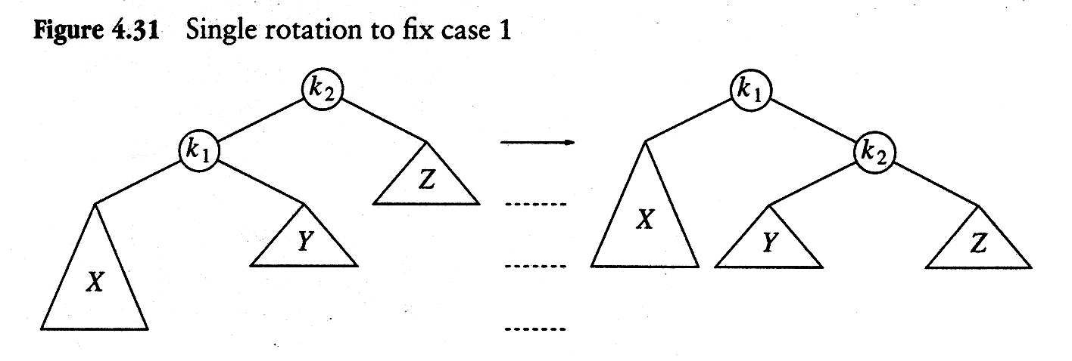
i.e. LL case

Slide 12


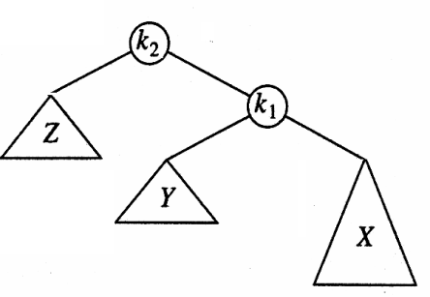
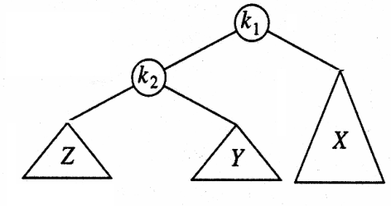
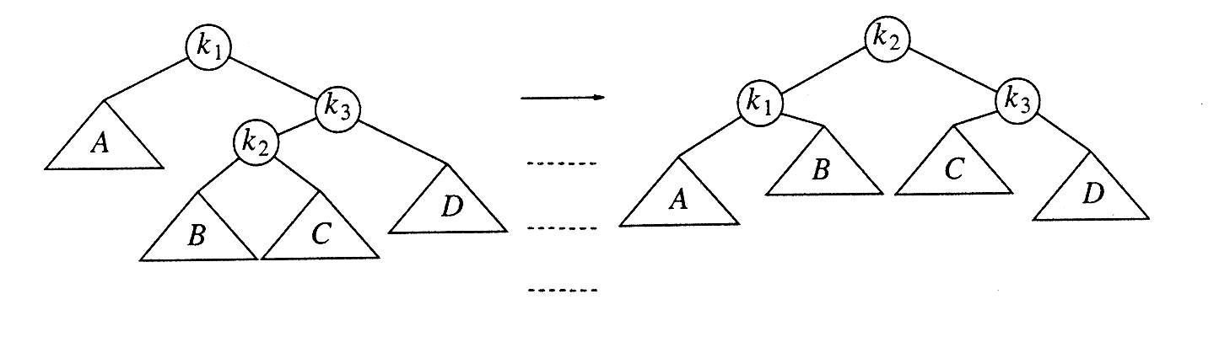

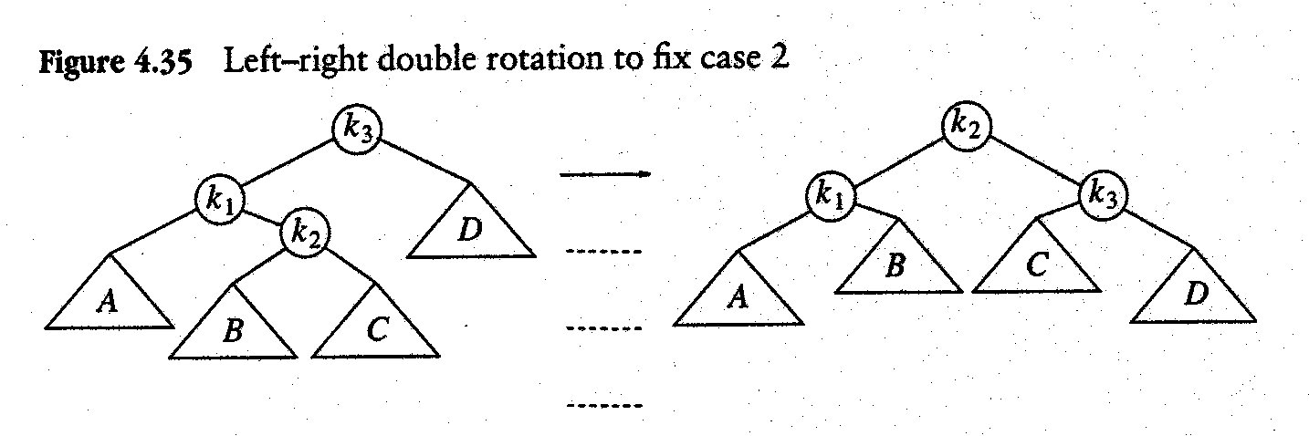


Slide 13
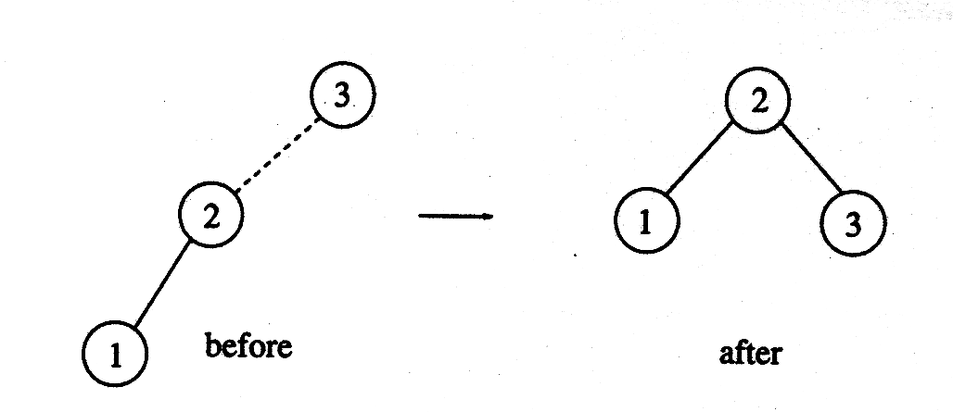

Example: 3 2 1 4 5 6 7
Construct AVL tree (height balanced)

Slide 14



i.e.RR case

Slide 15
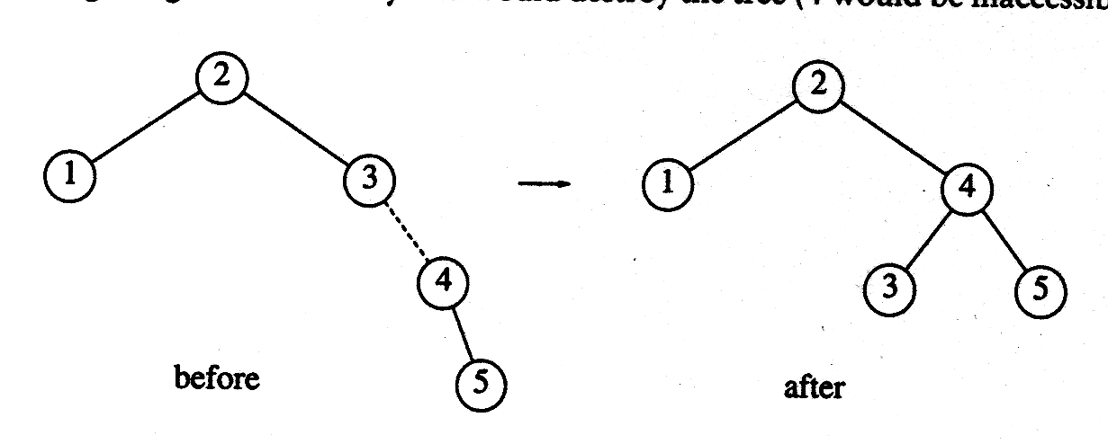
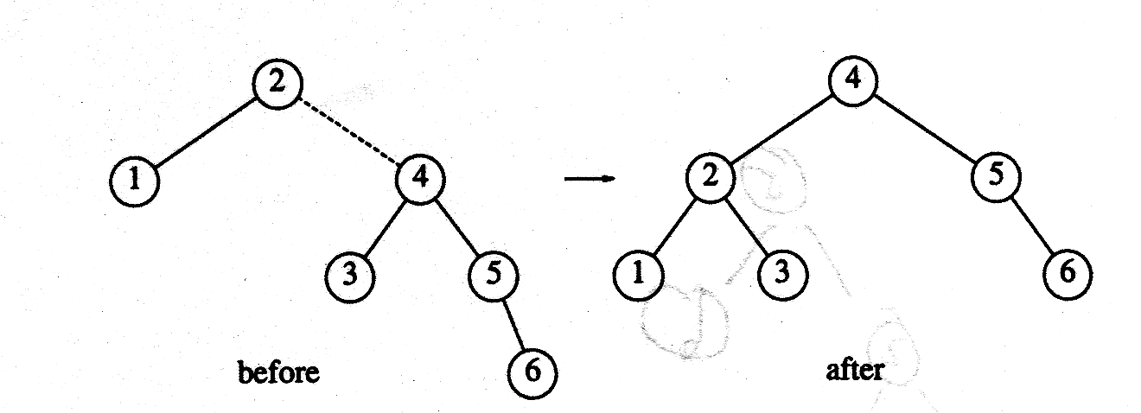
Insert 4, 5
Insert 6

Slide 16
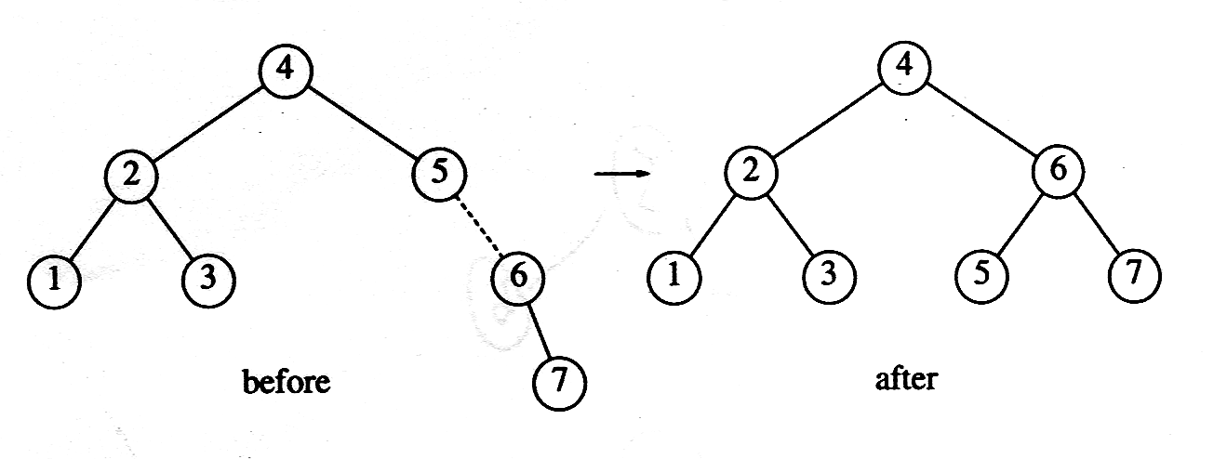
Insert 7
Now Insert 16 and then 15

Slide 17
(LR case)

Slide 18
RL case

Slide 19
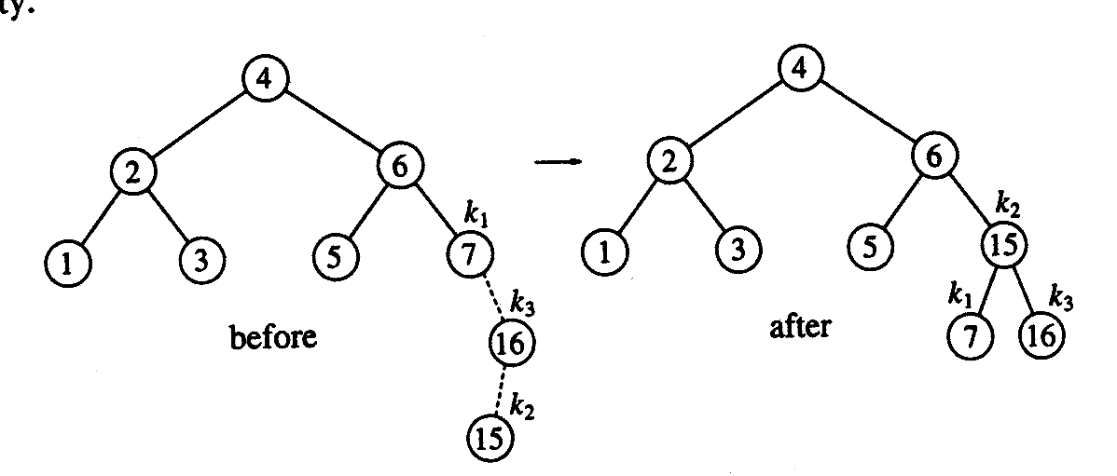
Example: RL

Slide 20
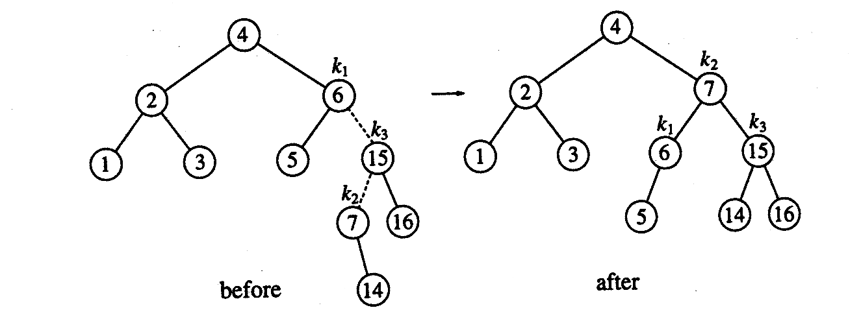

Insert 14

Slide 21
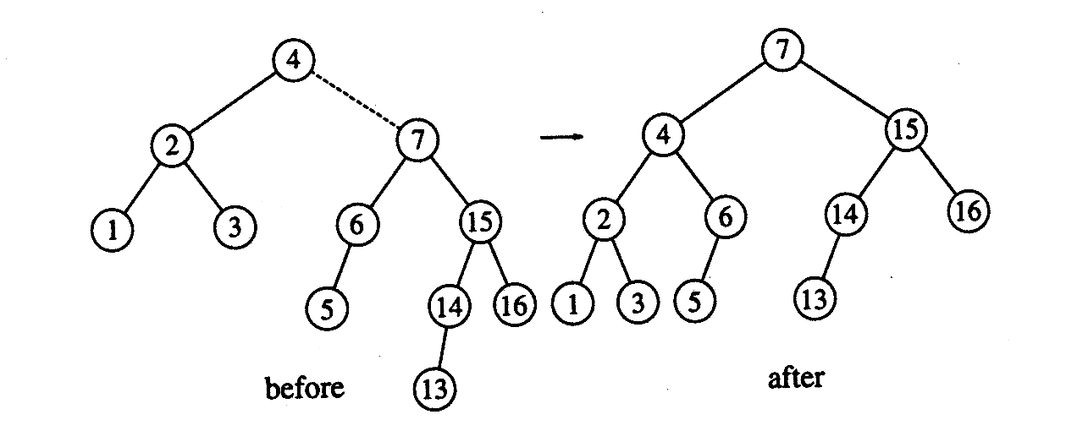
Insert 13 (RR Case)

Slide 22
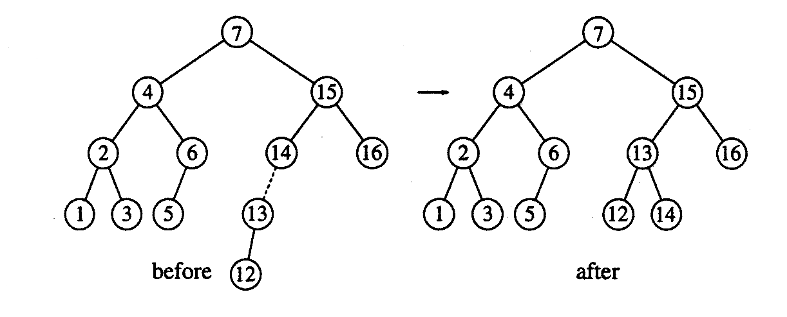

Insert 12 (LL case)

Slide 23
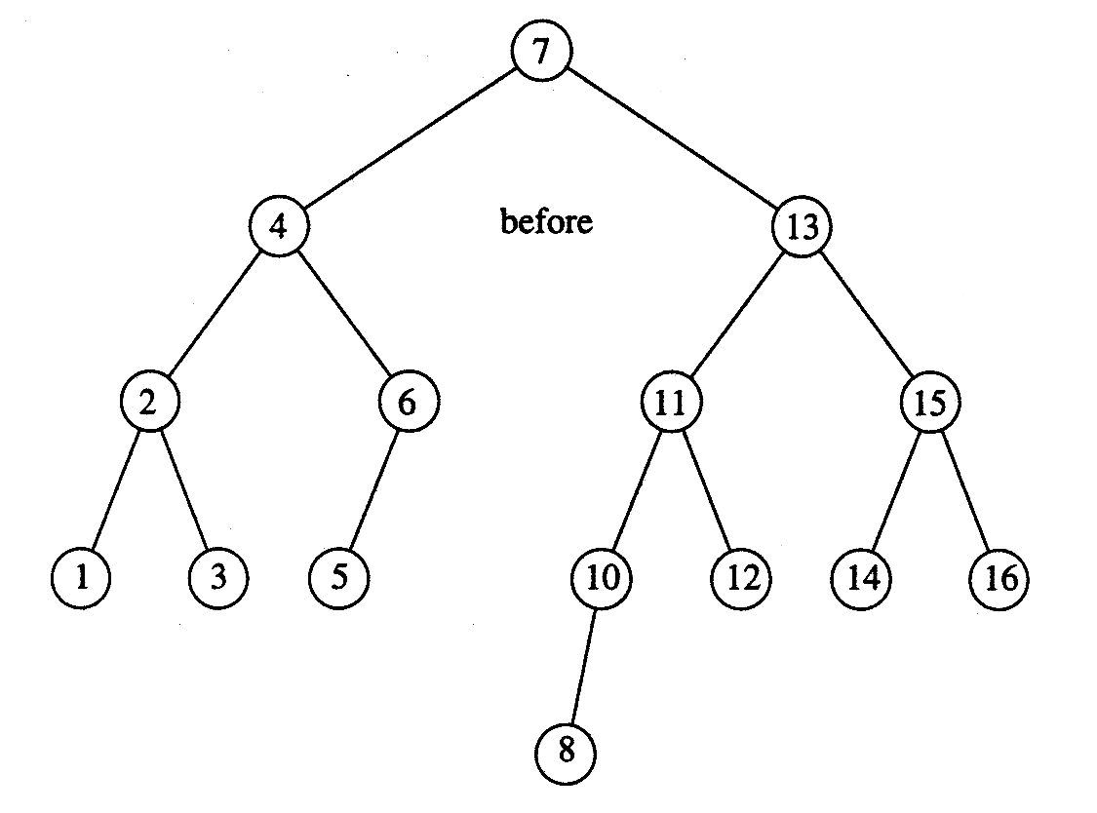
Insert 11 and 10 , then 8

Slide 24
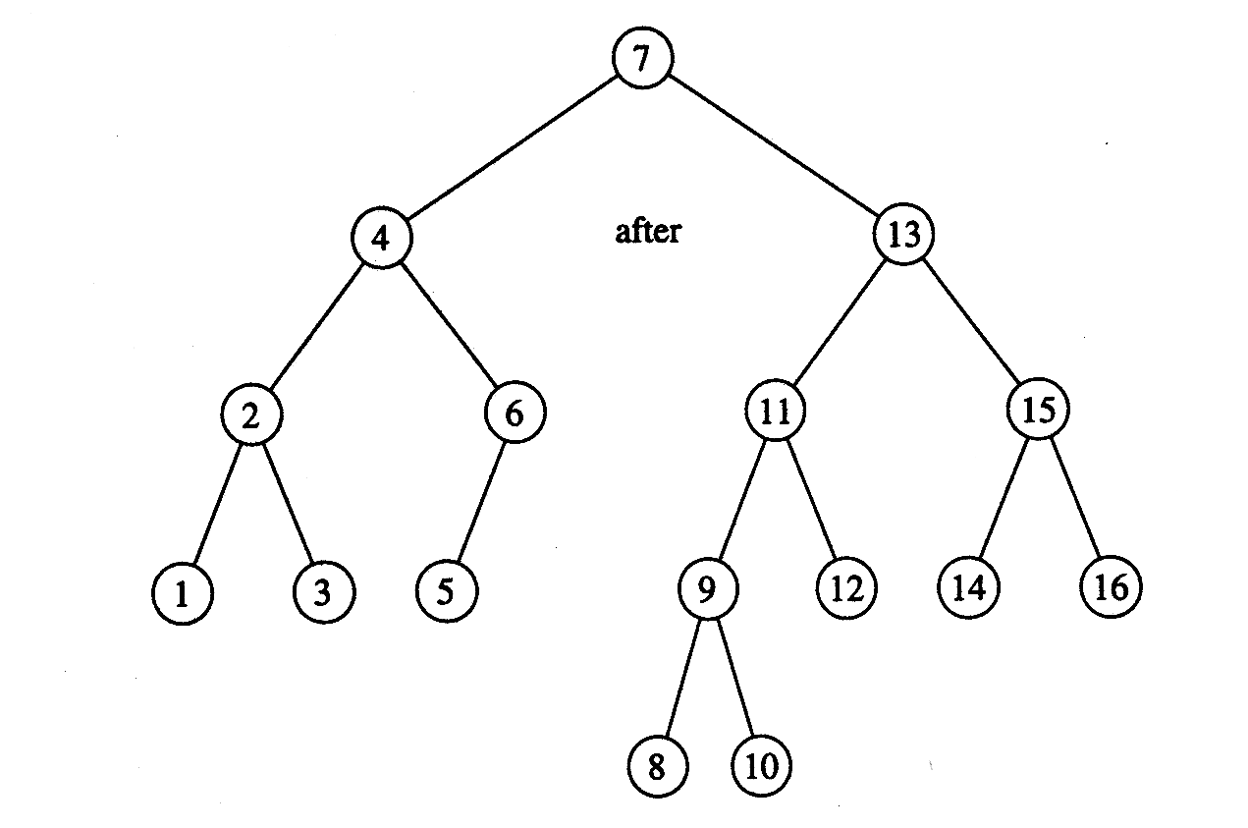
Inserting 9

